Slide 1
Angular Lifecycle
A Deep Dive into Angular’s Component Lifecycle Hooks

Slide 2
Introduction to Angular
What is Angular?
A popular web development framework for building client-side applications.
Developed and maintained by Google.
Key Features of Angular:
Component-based architecture.
Two-way data binding.
Dependency injection, etc.

Slide 3
Introduction to Angular Lifecycle
Angular Components:
Small, self-contained units of functionality.
Lifecycle Hooks:
Special methods provided by Angular to tap into the lifecycle of components.
Importance:
Helps manage and understand how components are initialized, updated, and destroyed.

Slide 4
Lifecycle Overview
Lifecycle Phases:
Creation
Change detection
Destruction
Hooks:
Functions Angular calls at key points in the component lifecycle.

Slide 5
Phases of Angular Component Lifecycle
Creation:
When the component is created.
Change Detection:
When Angular checks for changes to component properties.
Destruction:
When the component is removed from the DOM.

Slide 6
OnInit – Initialization Phase
Method:
ngOnInit()
Called When:
After the component’s data-bound properties have been initialized.
Use Case:
Fetch initial data, setup properties, initialize subscriptions.

Slide 7
DoCheck – Custom Change Detection
Method:
ngDoCheck()
Called When:
During each change detection run, right after default checks.
Use Case:
Custom change detection handling.

Slide 8
OnChanges – Respond to Changes
Method:
ngOnChanges()
Called When:
When input-bound properties change.
Use Case:
Respond to input property changes and take actions accordingly.

Slide 9
AfterContentInit & AfterContentChecked
ngAfterContentInit():
Called after content (e.g., child components) has been projected into the view.
ngAfterContentChecked():
Called after Angular checks the content each time change detection occurs.

Slide 10
AfterViewInit & AfterViewChecked
ngAfterViewInit():
Called after the component’s view and child views are initialized.
ngAfterViewChecked():
Called after the component’s view and child views have been checked by the change detection mechanism.

Slide 11
OnDestroy – Clean-up Phase
Method:
ngOnDestroy()
Called When:
Right before the component is removed from the DOM.
Use Case:
Unsubscribe from observables, detach event listeners, and clean up resources.

Slide 12
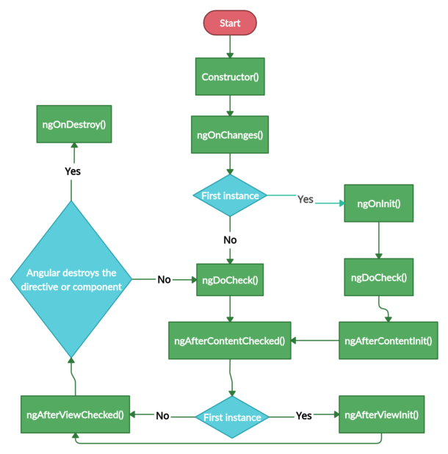
Diagram: Angular Lifecycle Hooks Sequence

Slide 13
Use Cases for Common Lifecycle Hook
OnInit:
Initializing data when a component is loaded.
OnChanges:
Handling dynamic input changes from the parent component.
OnDestroy:
Cleaning up when the component is removed.

Slide 14
Best Practices with Lifecycle Hooks
Avoid complex logic in hooks.
Always unsubscribe from observables in OnDestroy.
Use OnInit for fetching data, not constructors.

Slide 15
Conclusion
Angular's lifecycle hooks provide fine-grained control over component behavior.
Understanding these hooks is crucial for developing efficient, maintainable Angular applications.

Slide 16
Thank You! Under the Guidance of Indrakka Mam Edubridge * Capgemini - Shridhar Pandey

